Slide 1
Image Captioning in Deep Learning
R.Preethi G.Renuka
2019PECCS165 2019PECCS172

Slide 2
INTRODUCTION
Deep Learning is a very rampant field right now – with so many applications coming out day by day.
And the best way to get deeper into Deep Learning is to get hands-on with it.
In this project, we will take a look at an interesting multi modal topic where we will combine both image and text processing to build a useful Deep Learning application which is Image Captioning.
Image Captioning refers to the process of generating textual description from an image – based on the objects and actions in the image

Slide 3
TECHNOLOGIES USED :
The objective of our project is to learn the concepts of a CNN and LSTM model and build a working model of Image caption generator by implementing CNN with LSTM.
In this Python project, we will be implementing the caption generator using CNN (Convolutional Neural Networks) and LSTM (Long short term memory).
The image features will be extracted from Exception which is a CNN model trained on the image net dataset and then we feed the features into the LSTM model which will be responsible for generating the image captions.

Slide 4
CNN
Convolutional Neural networks are specialized deep neural networks which can process the data that has input shape like a 2D matrix.
Images are easily represented as a 2D matrix and CNN is very useful in working with images.
CNN is basically used for image classifications and identifying if an image is a bird, a plane or Superman, etc.

Slide 5
LSTM
LSTM stands for Long short term memory, they are a type of RNN (recurrent neural network) which is well suited for sequence prediction problems.
Based on the previous text, we can predict what the next word will be It has proven itself effective from the traditional RNN by overcoming the limitations of RNN which had short term memory.
LSTM can carry out relevant information throughout the processing of inputs and with a forget gate, it discards non-relevant information.

Slide 6
What is image captioning USING deep learning?
Image Captioning is the process of generating a textual description for given images.
It has been a very important and fundamental task in the Deep Learning domain.
Image captioning has a huge amount of application.
Image Captioning is the process of generating textual description of an image.
It uses both Natural Language Processing and Computer Vision to generate the captions.

Slide 7
EXISTING SYSTEM
Deep learning based image captioning methods:
Dense captioning
Neural encoder-decoder based approaches
Semantic Concept-Based Image Captioning
Typical novel object-based image captioning
Caption model and forgetting in neural networks
The proportion of the existing system that gives the output as audio or used visually impaired people is almost nil.

Slide 8
PROPOSED SYSTEM
Image captioning is the process of recognizing the important objects, their attributes, and their relationships in an image.
It also needs to generate syntactically and semantically correct sentences.
Deep-learning-based techniques are capable of handling the complexities and challenges of image captioning.
In this project, we aim to use deep-learning-based image captioning techniques in an innovative way.
We’ll see datasets and the evaluation metrics popularly used in deep-learning-based automatic image captioning.
The dataset will be in the form [image → captions]. The dataset consists of input images and their corresponding output is captions.
The innovation in this idea is to convert this caption into audio message which is a major advantage to this system.

Slide 9
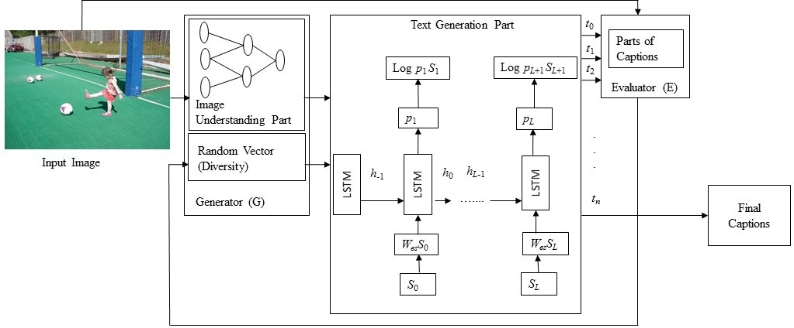

Slide 10
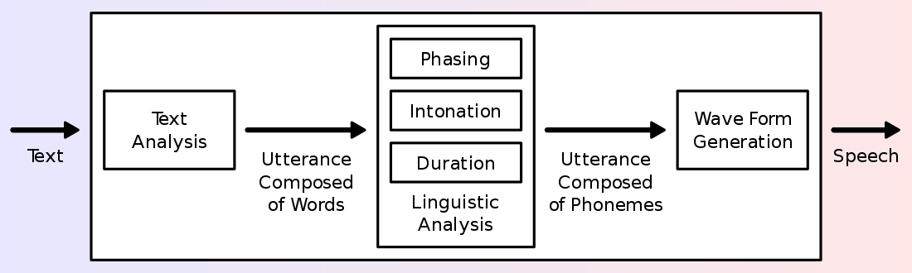

Slide 11
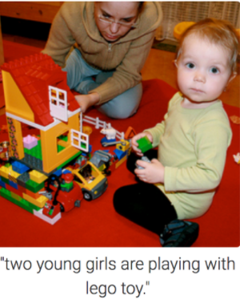
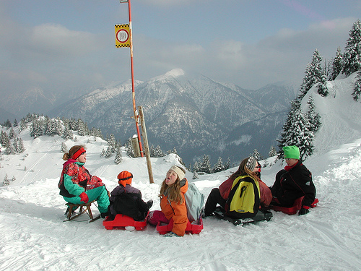
Five people are sitting together in the snow.
IMAGE ILLUSTRATION

Slide 12
SUMMARY
Our project is all about to know and use tech like CNN, LSTM, deep learning to read the image which is given as input and get the description of the image which is again converted as audio output. This system can safeguard the life of visually challenged people while they are crossing roads.

